Slide 1
Game Flux Analysis with Provenance
Authors: Troy C. Kohwalter,
Esteban W. G. Clua, Leonardo G. P. Murta
Instituto de Computação – Universidade Federal Fluminense (UFF)

Slide 2

Introduction
Detect gameplay issues
Artisanal
Beta Testing
Cause-and-Effect
How to detect?
Archeology, Paleontology
Provenance
Notes:
The analysis process for detecting gameplay issues is done nowadays in an artisanal way by using a popular beta testing [1] approach. The beta test phase is an indispensable source of data for the developers about technical issues or bugs found in the game. Normally, beta testers are volunteers who were recruited to play the game in an early, pre-release, build of the game where they can provide information about technical issues and provide feedback about the gameplay mechanics. Thus, beta testing is a crucial part of the development to identify important issues in the game. However, developers have little control over the beta testers’ gameplay experience or the environment because they can play at home.
The goal of this paper is to improve the game designer’s understanding of the game flowflux, providing insights on how the gameplay progressed and influences in the outcome.
No entanto, outras áreas utilizam um outro método de analise, permitindo saber com mais detalhes as transformações ou alterações sofridas pelas entidades envolvidas. Esse método é baseado em Proveniência.

Slide 3
Provenance
“Refers to the documented history of an art object, or the documentation of processes in a digital object’s life cycle”
Models:
OPM (2007)
PROV (2010)
Provenance Graph
Causality Graph
Notes:
Grafo de Causalidade: registra a trajetória de vida de um processo ou artefato
Proveniência conta com um grafo orientado de causalidades, mantendo um registro de execuções passadas ou correntes.
Vale a pena lembrar que o grafo de proveniência não é uma descrição do que pode ter ocorrido, e sim os fatos que ocorreram.
A orientação de um grafo de proveniência é do presente para o passado.
Os nós no grafo de proveniência podem ser de 3 tipos: Artefatos ou também chamados de entidades, processos ou atividades, e de agentes.

Slide 4

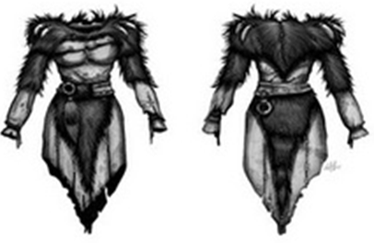
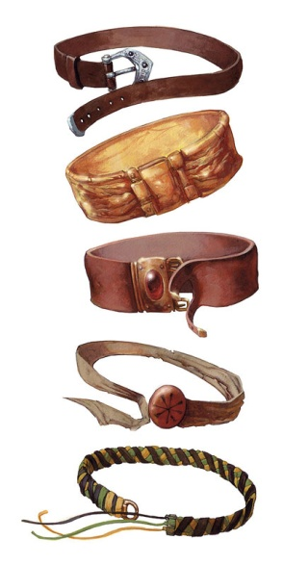
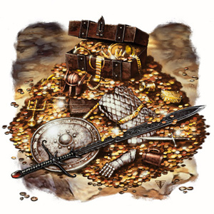
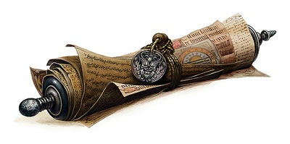
Provenance Gathering
Entity
Objects
Activity
Actions
Events
Agent
NPCs
Player
Notes:
In our previous work [2], we introduced the usage of digital provenance [3] in games. The main goal of the previous work was to propose a framework that collects information during a game session and maps it to provenance terms, providing the means for a post-game analysis.

Slide 5
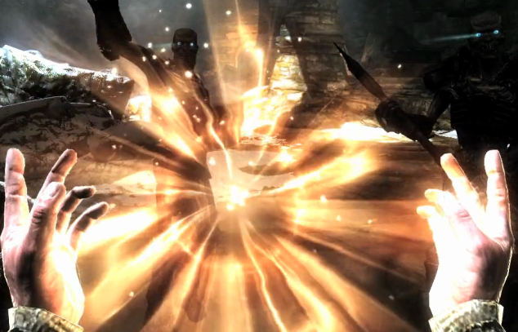

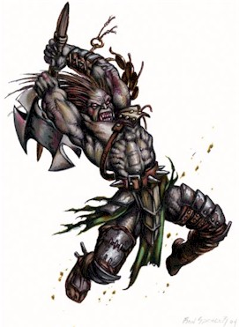
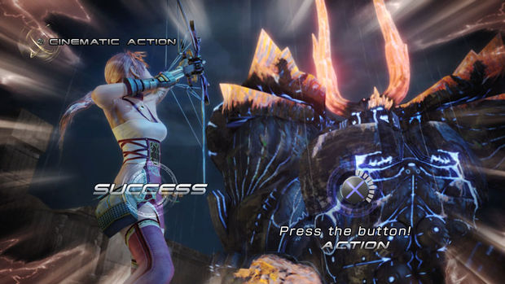
Provenance Gathering
Entity
Objects
Activity
Actions
Events
Agent
NPCs
Player

Slide 6
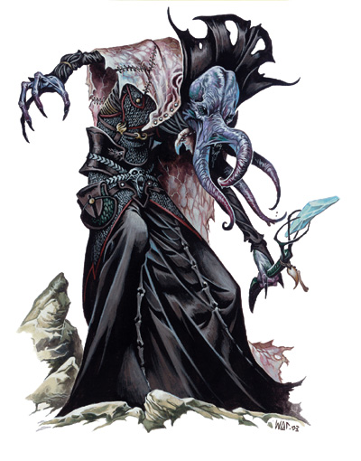
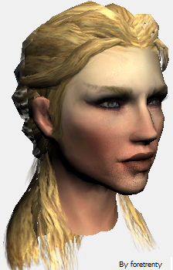
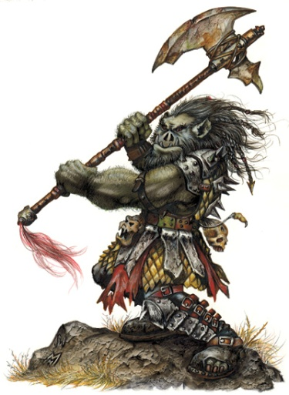

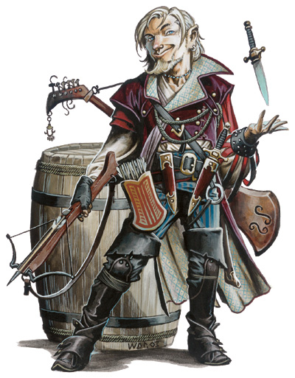
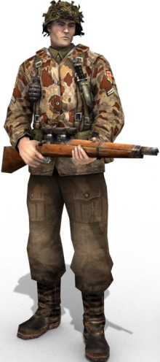
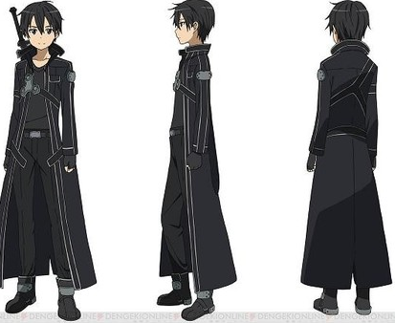
Provenance Gathering
Entity
Objects
Activity
Actions
Events
Agent
NPCs
Player

Slide 7
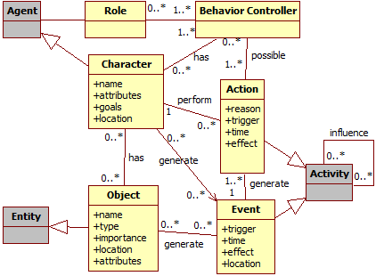
Provenance Gathering
Notes:
Diagrama de classe do mapeamento

Slide 8
Graph Construction
Mage
Orc
Notes:
Exemplo: Combate

Slide 9
Graph Construction
Mage
Orc
- 23hp
Spell:
Lightning Bolt
Notes:
Exemplo: Combate

Slide 10
Graph Construction
Mage
Orc
- 23hp
Spell:
Lightning Bolt
- 18hp
Attack
(Hit)
Notes:
Exemplo: Combate

Slide 11
Graph Construction
Mage
Orc
- 23hp
Spell:
Lightning Bolt
- 18hp
Attack
(Hit)
+ 15hp
Spell :
Heal
Notes:
Exemplo: Combate

Slide 12
Graph Construction
Mage
Orc
- 23hp
Spell:
Lightning Bolt
- 18hp
Attack
(Hit)
+ 15hp
Spell :
Heal
Attack
(Miss)
Notes:
Exemplo: Combate

Slide 13
Graph Construction
Mage
Orc
- 23hp
Spell:
Lightning Bolt
- 18hp
Attack
(Hit)
+ 15hp
Spell :
Heal
Attack
(Miss)
Spell :
Stoneskin
Notes:
Exemplo: Combate

Slide 14
Graph Construction
Mage
Orc
- 23hp
Spell:
Lightning Bolt
- 18hp
Attack
(Hit)
+ 15hp
Spell :
Heal
Attack
(Miss)
- 8hp
Spell :
Stoneskin
Attack
(Hit)
Reduced 10 damage
Notes:
Exemplo: Combate

Slide 15

Provenance Visualization
Notes:
The present paper is based on the conceptual framework definition introduced in the previous paper. However, while in the previous work focused on the provenance gathering, this work focuses on the provenance graph construction and manipulation to support analysis.

Slide 16
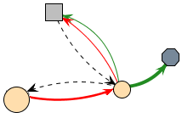
Provenance Visualization

Slide 17
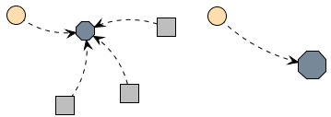
Provenance Visualization

Slide 18
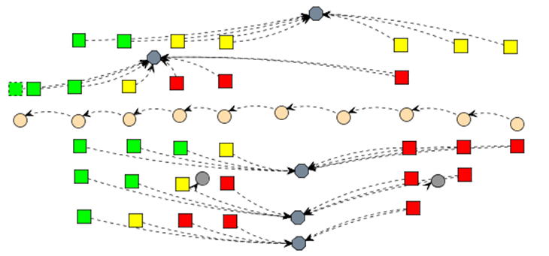
Provenance Visualization

Slide 19
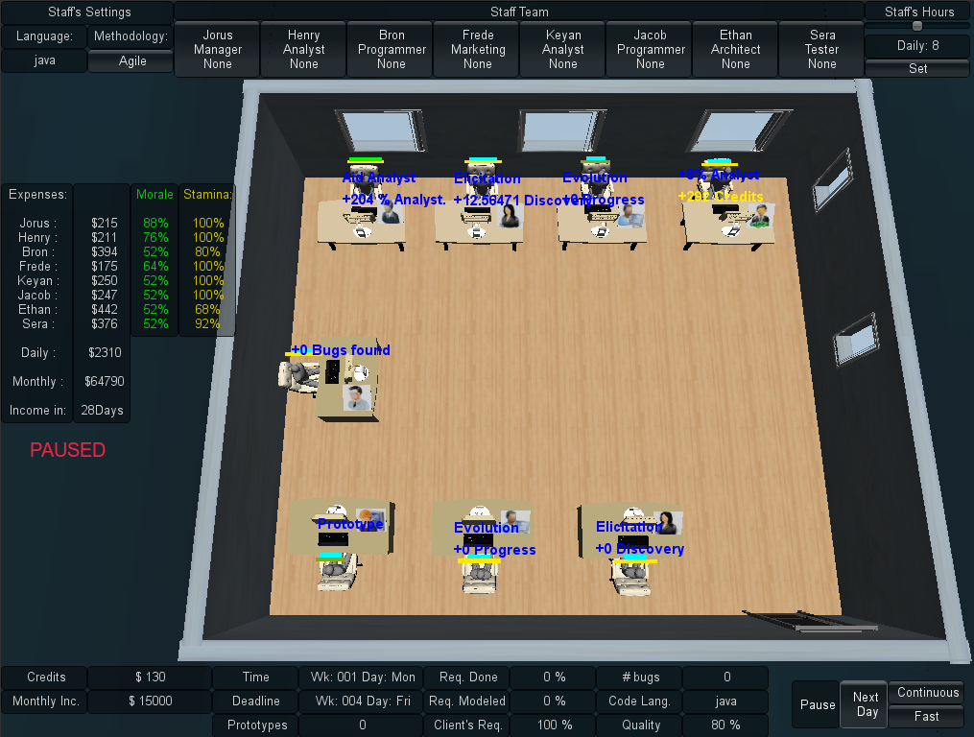
Case Study
Notes:
Apresentação do SDM simplificada
Descrever o SDM nesse slide

Slide 20
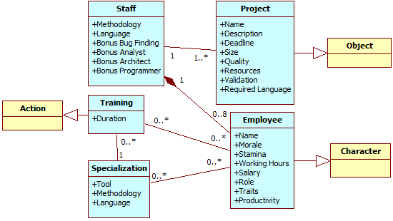
Case Study
Notes:
SDM & Prov Gathering
Falar apenas do mapeamento do SDM para o Provenance in Games

Slide 21
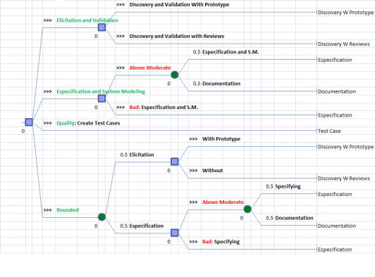
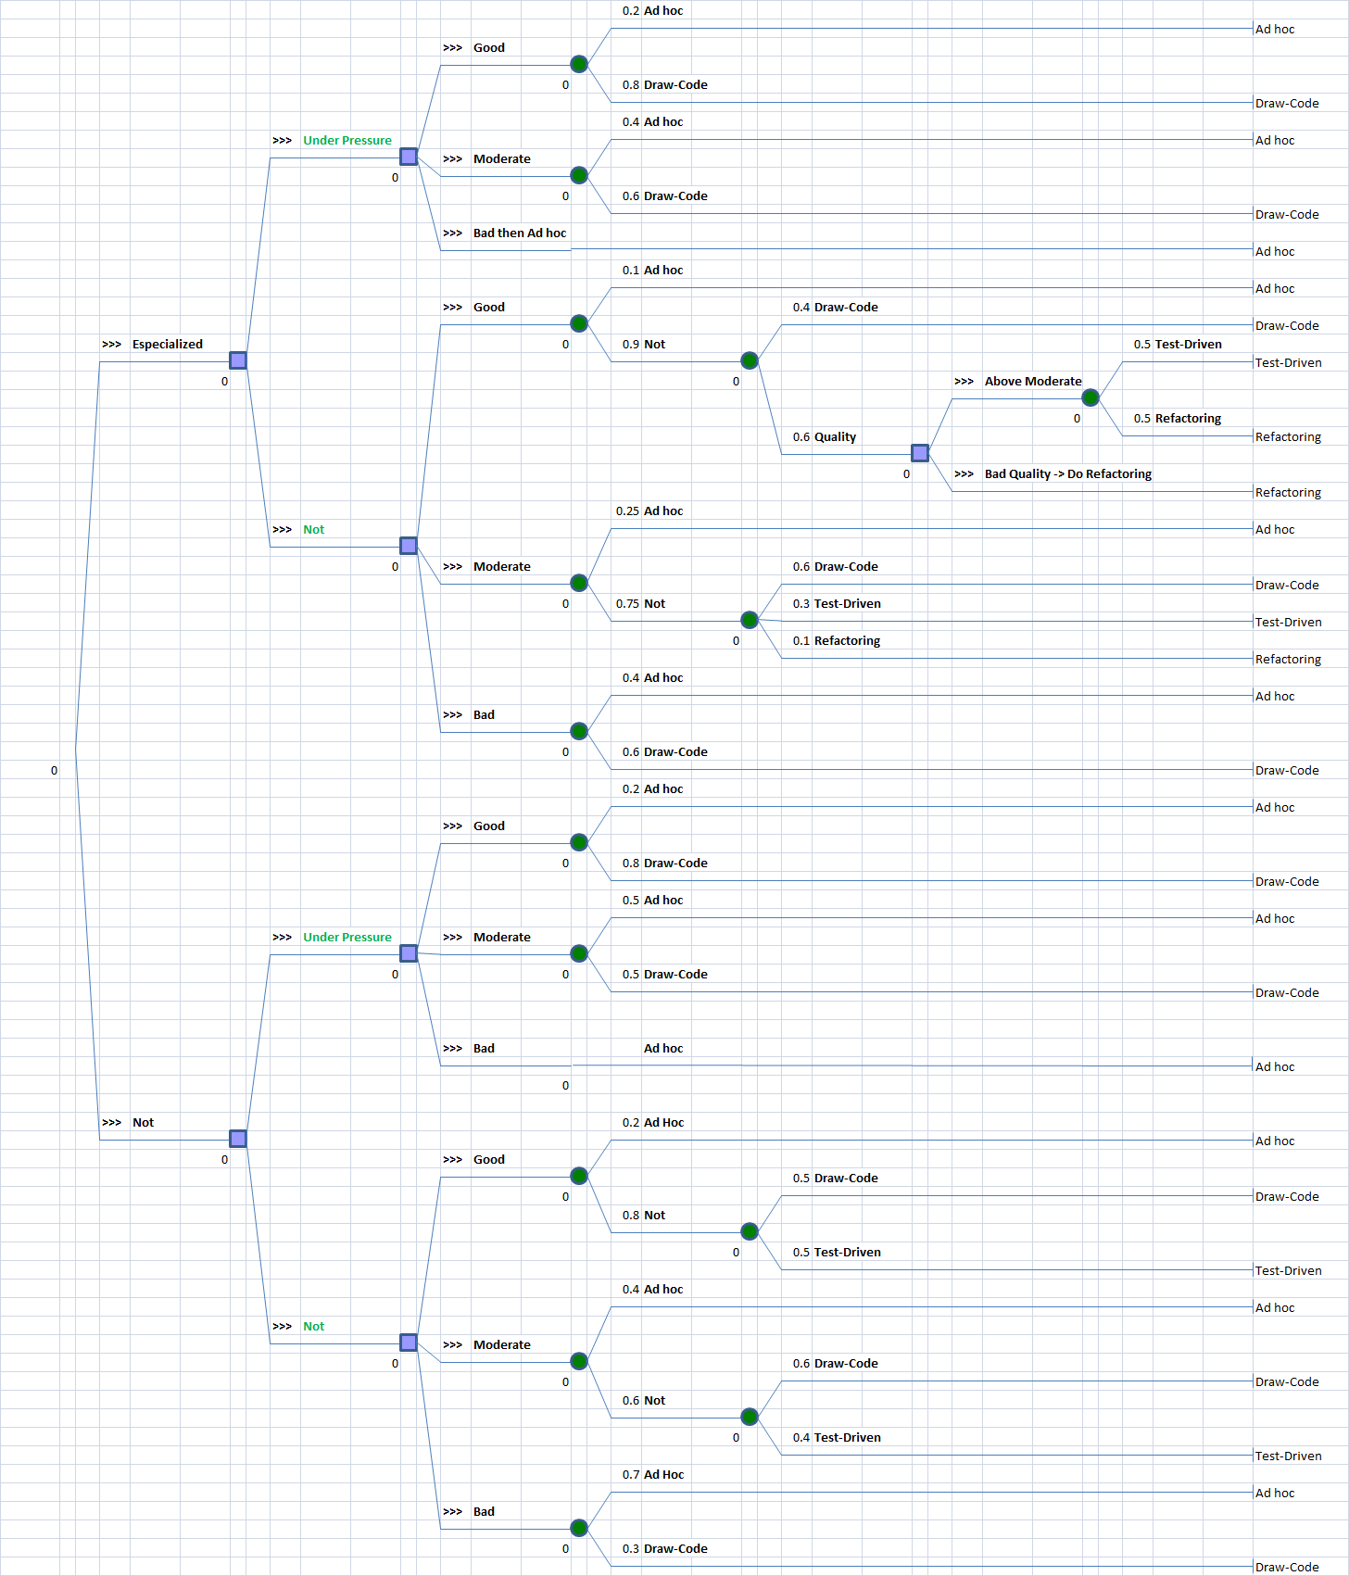
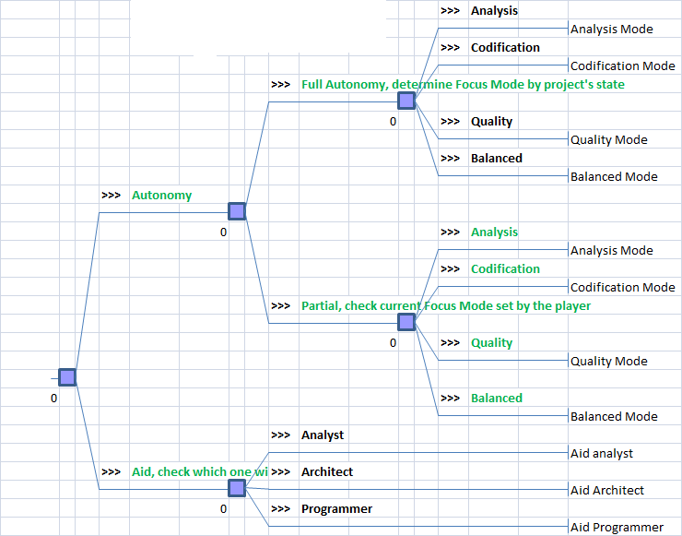
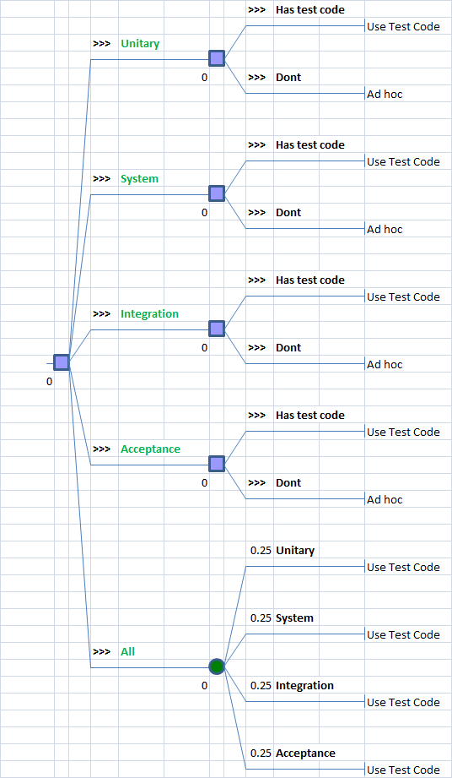
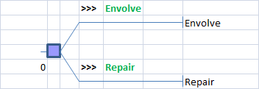
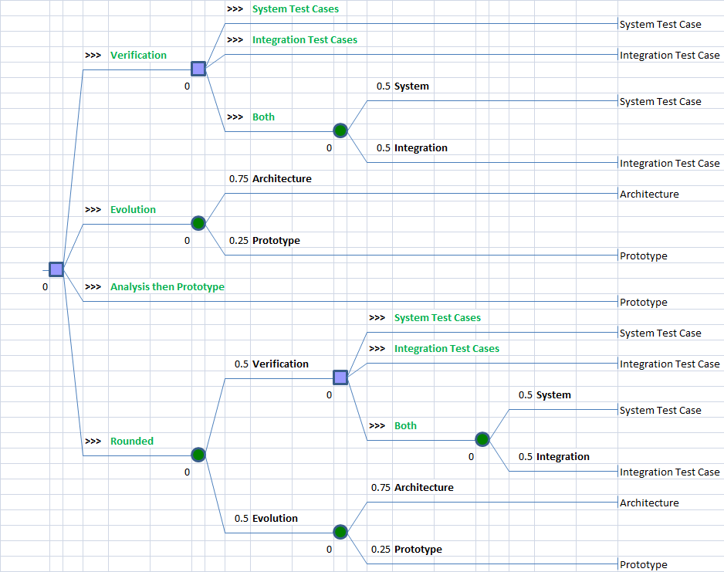
Case Study
Notes:
Falar que a coleta de proveniencia é realizada nas folhas das arvores
O jogo foi revisado, alterando os métodos de cada papel para utilizar arvores de decisões e que na folha da árvore é onde ocorre a execução da ação e a coleta de dados.

Slide 22
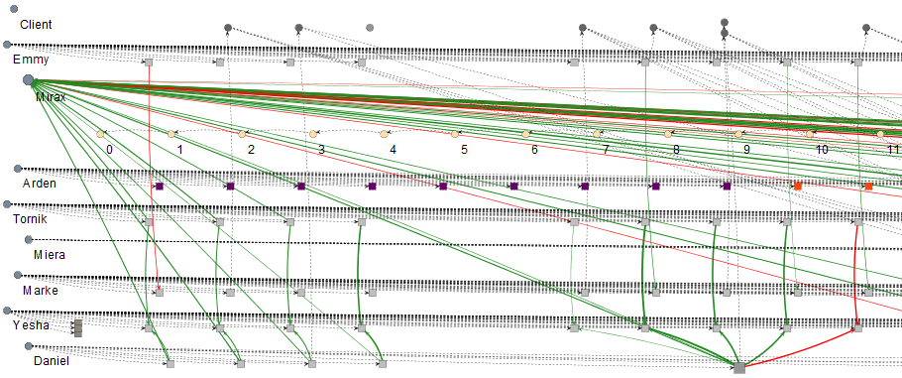
Visualization Examples
Notes:
Agent Collapse: Agent’s Influences

Slide 23
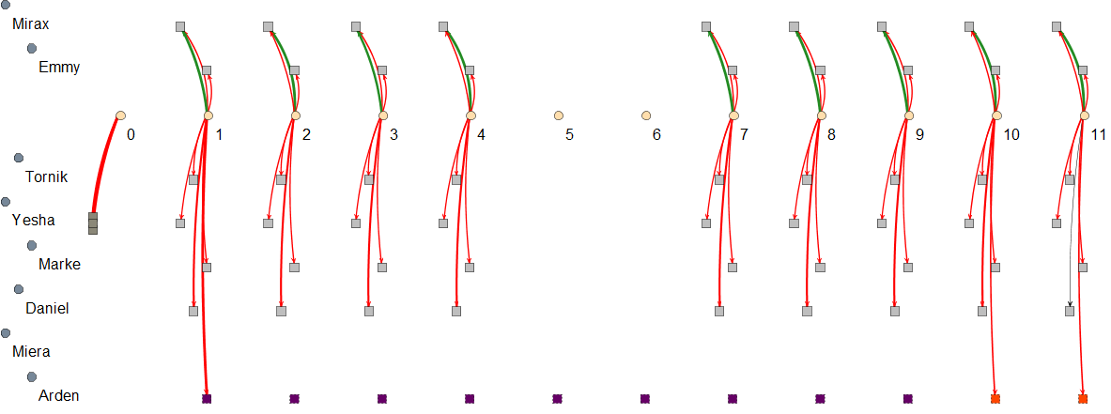
Visualization Examples
Notes:
Edge Filter: Edge Credits

Slide 24
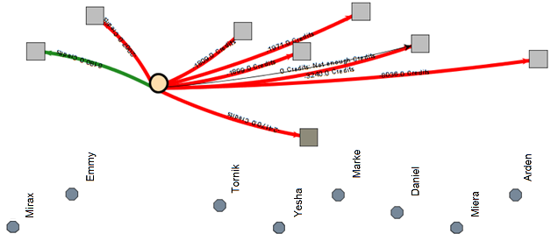
Visualization Examples
Notes:
Collapsed Vertex: Credit edges

Slide 25
Conclusion
Contribuições
New perspectives on gameplay
Modeling & Analysis
Aid detect gameplay issues
Future Work
Automatic Inferences
Pattern Detection
Graph Layouts

Slide 26
Game Flux Analysis with Provenance
Authors: Troy C. Kohwalter,
Esteban W. G. Clua, Leonardo G. P. Murta
Instituto de Computação – Universidade Federal Fluminense (UFF)

